Slide 1
DragonFriends
“Connecting students one scale at a time”

Slide 2
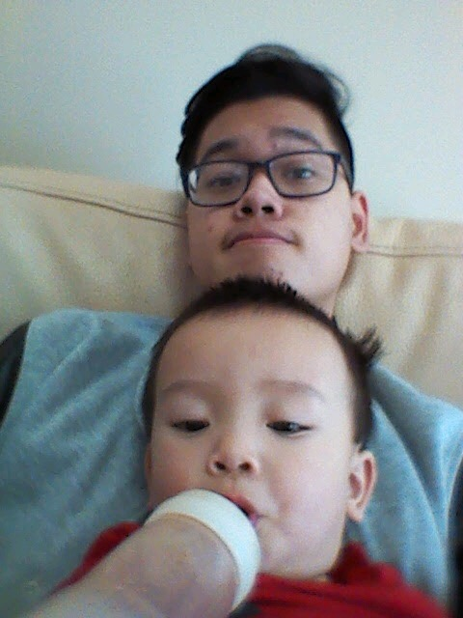
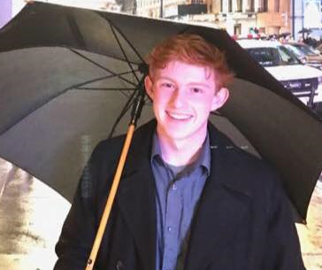
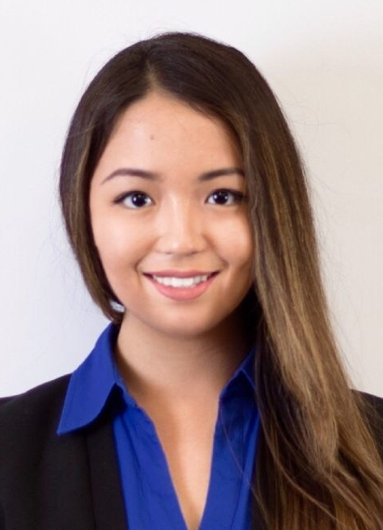
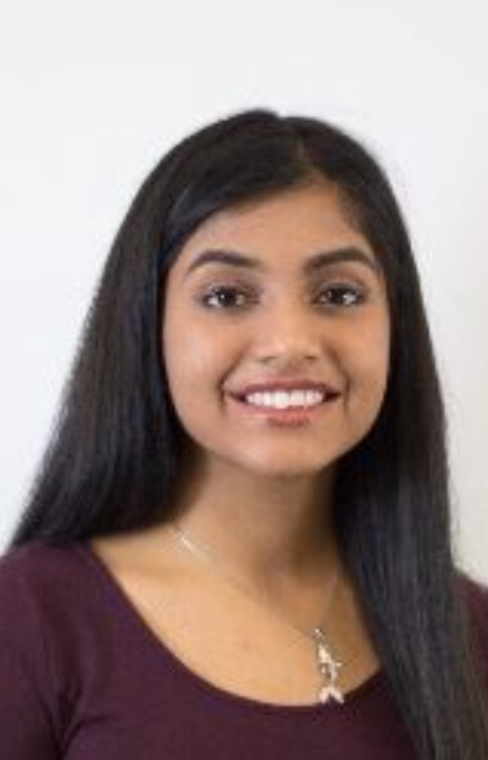

Meet the team
Carter Knight -Project Manager | Tri Le- Application Developer/ Support Manager
Alia Yeszhanova- Application Developer/Technical Designer | Sahithi Pisupati- Application Developer/Technical Designer
Victoria Young- Technical Designer/Application Developer

Slide 3
What’s the issue?
Let’s face it: starting a brand new term is hard. Especially finding friends or classmates in the course before the first day. Here’s where DragonFriends steps in: our application will help Drexel Students match their schedule along with other students with the same courses to help users build a network.
Instead of students individually texting their contacts or posting their schedule via social media, they can now conveniently find classmates through each courses rosters

Slide 4
Project Scope
Deliverables: A mobile application (Android) with...
1. A system that allows users to enter credentials (Drexel email address) and sign up with an account
2. A search engine that students can search and enter their classes by quarter though courses on a database provided by the Term Master Schedule(TMS)
3. Rosters for each course, that allow users to see the people in their classes and vice versa. They can also select privacy settings to choose how their information is publicized

Slide 5
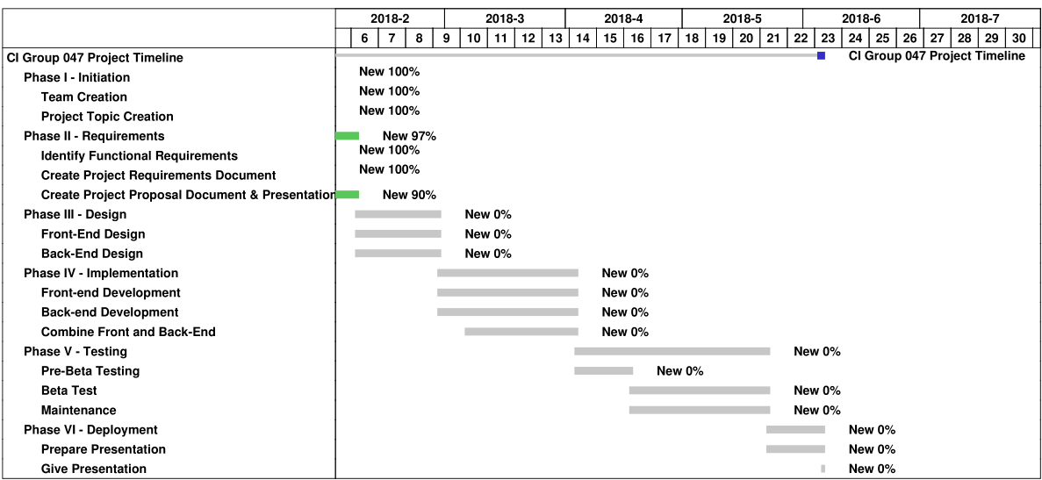
Project Time Frame

Slide 6
Project Resources
Funding: although not needed for development, could be possible for future development once application is launched, through Drexel funding. There are no costs needed currently.
Personnel: Team members will dedicate a large portion of time and effort towards development, but especially testing.

Slide 7
Technologies needed
Software: Android Studio to develop the mobile application
Firebase to use as our database backend
Access to list of classes from Term Master Schedule(TMS)
Hardware: Android phone for testing
Micro USB / USB-C cord to connect

Slide 8
Project Activities
 | Month 1 | Month 2 | Month 3 | Month 4
Design user interface for all screens | X
Develop user authentication | X
Develop searching and adding for classes features | X | X | X
+ Integrating an API for TMS |  | X | X
Develop user profile | X | X
Develop view other’s schedules features |  |  | X | X

